Slide 1
Generating functions
Week - 2

Slide 2
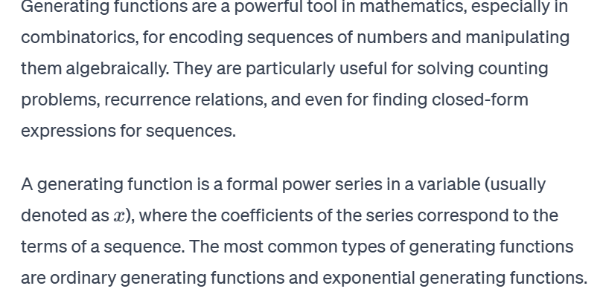
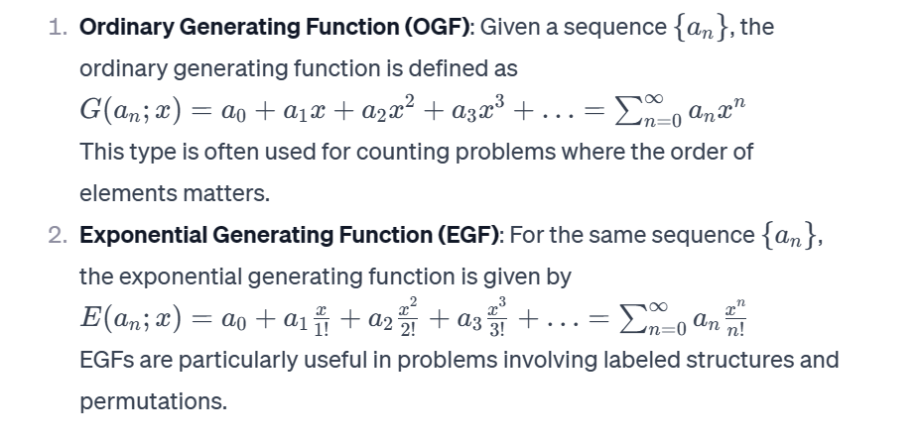

Slide 3
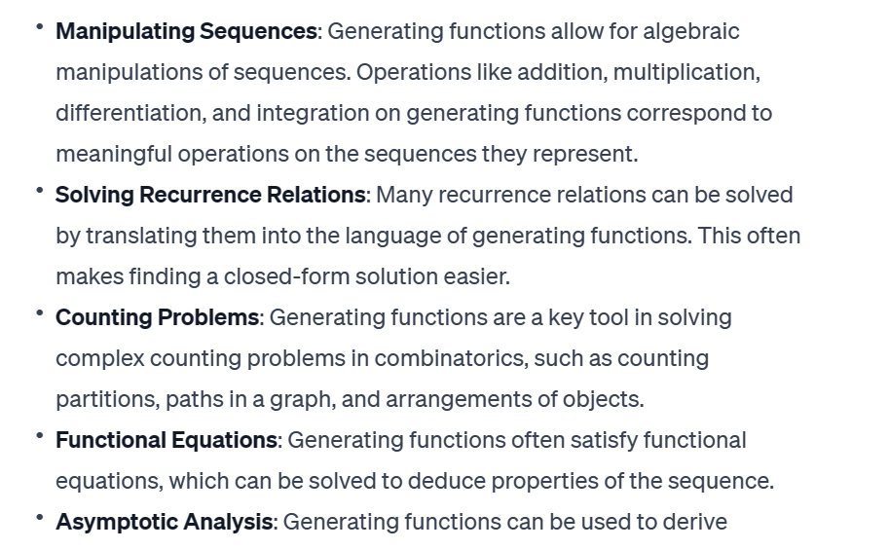

Slide 4
Ordinary Generating Functions
Often, our goal in the analysis of algorithms is to derive specific expressions for the values of terms in a sequence of quantities a0 ,a1 ,a2 , … 0 ,1 ,2 ,… that measure some performance parameter. In this chapter we see the benefits of working with a single mathematical object that represents the whole sequence.

Slide 5

Definition. Given a sequence a0,a1,a2,…,ak,…0,1,2,…,,…, the function
is called the ordinary generating function (OGF) of the sequence. We use the notation [z^k]A(z) to refer to the coefficient ak.

Slide 6
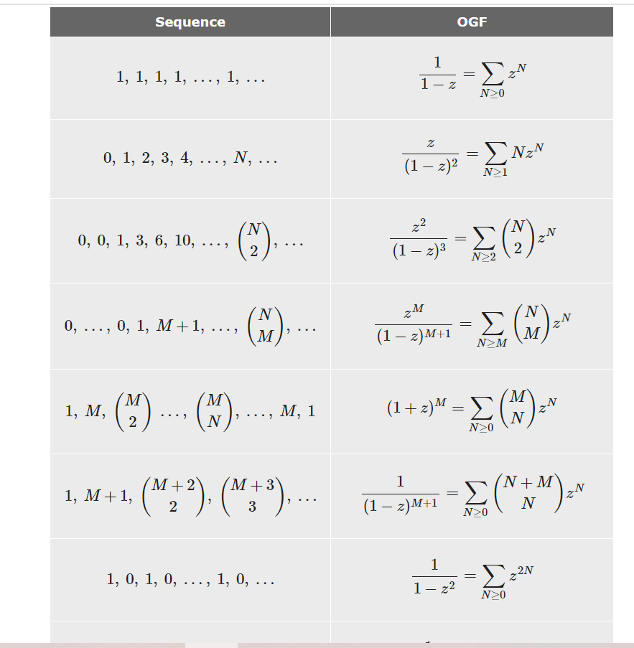

Slide 7
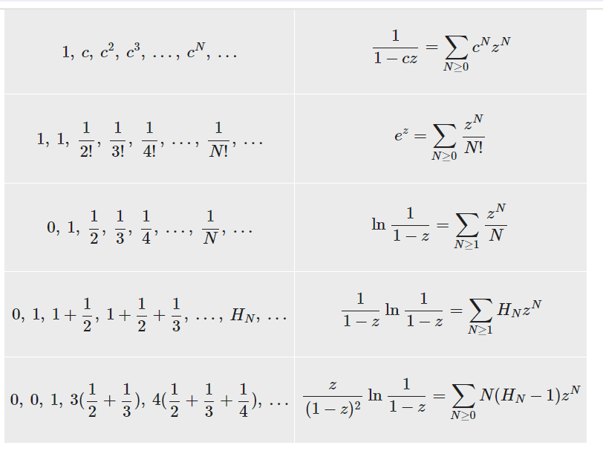

Slide 8
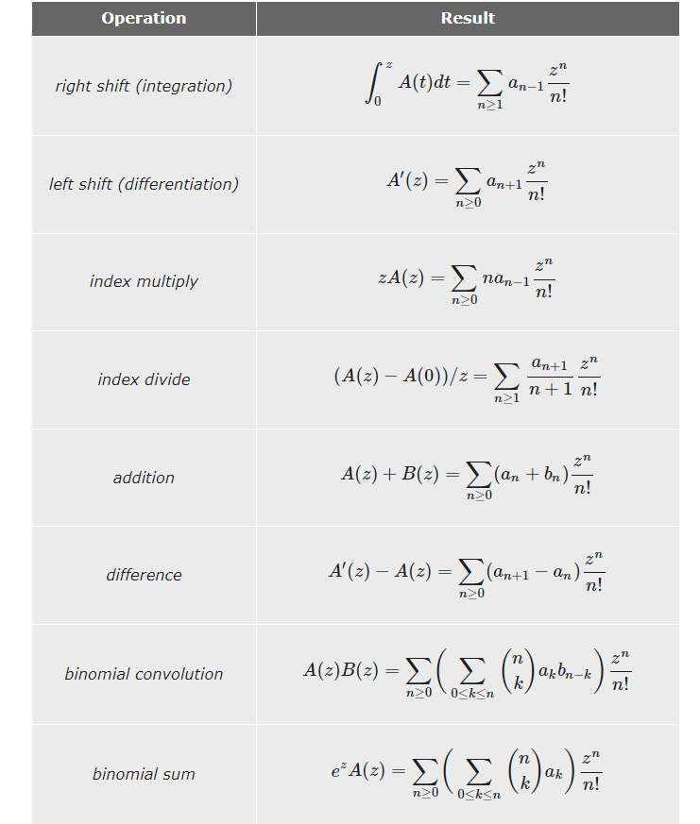
As with OGFs, application simple operations on these basic functions yields a large fraction of the EGFs that arise in practice. Note that the shift left/right operations for EGFs are the same as the index multiply/divide operations for OGFs and vice versa.

Slide 9
Catalan numbers
Catalan numbers are defined as a mathematical sequence that consists of positive integers, which can be used to find the number of possibilities of various combinations.
The first few Catalan numbers for n = 0, 1, 2, 3, … are : 1, 1, 2, 5, 14, 42, 132, 429, 1430, 4862, …

Slide 10
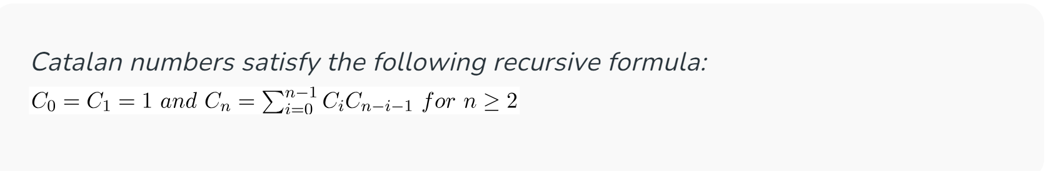
Program for n^{th} Catalan Number using Recursion:

Slide 11
Step-by-step approach
Base condition for the recursive approach, when n <= 1, return 1
Iterate from i = 0 to i < n
Make a recursive call catalan(i) and catalan(n – i – 1) and keep adding the product of both into res.
Return the res.

Slide 12
Following is the implementation of the above recursive formula in C++
#include <iostream>
using namespace std;
// A recursive function to find nth catalan number
unsigned long int catalan(unsigned int n)
{
// Base case
if (n <= 1)
return 1;
// catalan(n) is sum of
// catalan(i)*catalan(n-i-1)
unsigned long int res = 0;
for (int i = 0; i < n; i++)
res += catalan(i) * catalan(n - i - 1);
return res;
}
int main()
{
for (int i = 0; i < 10; i++)
cout << catalan(i) << " ";
return 0;
}

Slide 13
Program for nth Catalan Number using Dynamic Programming:
We can observe that the above recursive implementation does a lot of repeated work. Since there are overlapping subproblems, we can use dynamic programming for this.

Slide 14
Step-by-step approach:
Create an array catalan[] for storing ith Catalan number.
Initialize, catalan[0] and catalan[1] = 1
Loop through i = 2 to the given Catalan number n.
Loop through j = 0 to j < i and Keep adding value of catalan[j] * catalan[i – j – 1] into catalan[i].
Finally, return catalan[n]

Slide 15
Following is the implementation of the above in C++
#include <iostream>
using namespace std;
// A dynamic programming based function to find nth
// Catalan number
unsigned long int catalanDP(unsigned int n)
{
// Table to store results of subproblems
unsigned long int catalan[n + 1];
// Initialize first two values in table
catalan[0] = catalan[1] = 1;
// Fill entries in catalan[] using recursive formula
for (int i = 2; i <= n; i++) {
catalan[i] = 0;
for (int j = 0; j < i; j++)
catalan[i] += catalan[j] * catalan[i - j - 1];
}
// Return last entry
return catalan[n];
}
// Driver code
int main()
{
for (int i = 0; i < 10; i++)
cout << catalanDP(i) << " ";
return 0;
}

Slide 16
Time Complexity: O(n²) Auxiliary Space: O(n)

Slide 17
Exponential Generating Functions
Exponential generating functions provide a way to encode the sequence as the coefficients of a power series. This encoding turns out to be useful in a variety of ways. Then f is the exponential generating function for A.

Slide 18
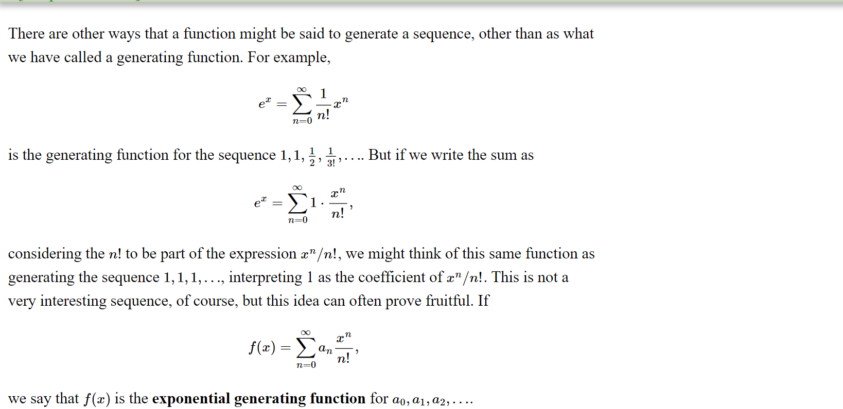

Slide 19
QUIZ TIME
1. What is a generating function in the context of Design and Analysis of Algorithms (DAA)?
Generating functions can be used to solve recurrence relations.
Generating functions are only applicable to numerical sequences.
Generating functions are primarily used for sorting algorithms.

Slide 20
QUIZ TIME
2. Which of the following is NOT a common operation performed on generating functions?
Integration
Differentiation
Multiplication
Addition

Slide 21
QUIZ TIME
3. Which of the following is an example of a generating function?
G(x) = 1 + x + x^2 + x^3 + ...
F(n) = n!
A(n) = 2^n
S(n) = n^2 + 3n + 5

Slide 22
QUIZ TIME
4. Which of the following is not catlan number?
1
14
5
43

Slide 23
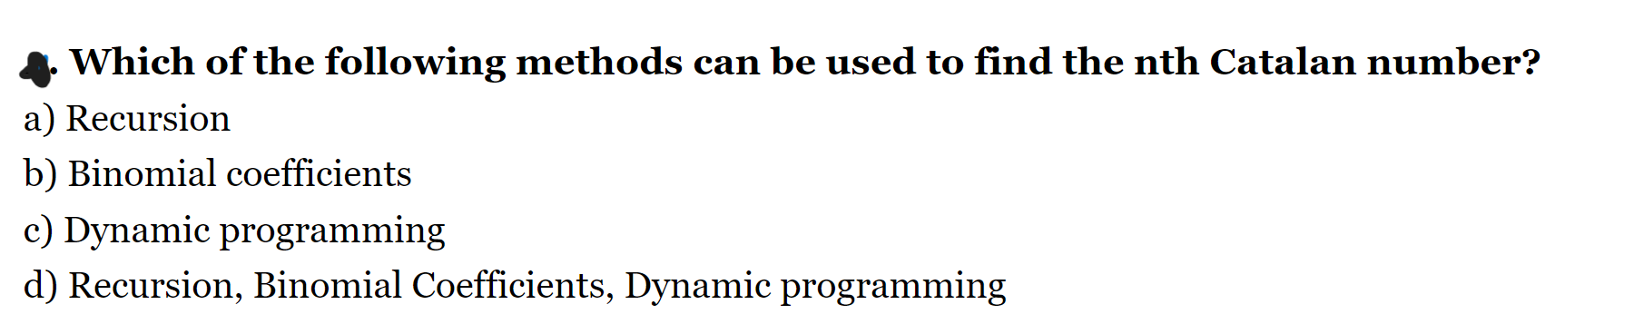
QUIZ TIME

Slide 24
QUIZ TIME
6. What is the pattern of the Catalan numbers?
1,3,5,8,89,98….
2,4,6,8,0,…
1, 2, 5, 14, 42, 132, 429, 1430, 4862, 16796,…….
58786, 208012, 742900, 2674440, 9694845,…..

Slide 25
QUIZ TIME
7. What is the primary use of Exponential Generating Functions (EGFs) in combinatorics and algorithm analysis?
A) Sorting algorithms
B) String manipulation
C) Counting and enumeration
D) Graph theory

Slide 26
QUIZ TIME
8.Which operation on Exponential Generating Functions corresponds to finding the nth derivative of the associated generating function?
A) Integration
B) Differentiation
C) Composition
D) Inversion

Slide 27
QUIZ TIME
9. Which of the following statements about generating functions in the context of design analysis and algorithms is true?
a) Generating functions are only useful in combinatorics and have no application in algorithmic design.
b) Generating functions are mathematical tools that can be used to represent and manipulate sequences of numbers, making them useful in analyzing algorithms.
c) Generating functions are limited to counting problems and cannot be applied to algorithmic efficiency analysis.
d) Generating functions are primarily used in physics and have minimal relevance in design analysis.

Slide 28
10.In the context of counting with generating functions, what does the coefficient of a specific term in a generating function represent?
a) The order of the generating function.
b) The exponent of the term in the generating function.
c) The number of ways a certain combinatorial problem can be solved.
d) The total number of terms in the generating function.

Slide 29
QUIZ TIME
11.When analyzing algorithms using Ordinary Generating Functions (OGFs), what is the role of the coefficient of x^{n} in the OGF?
a) It represents the order of the OGF.
b) It corresponds to the exponent of x in the OGF.
c) It indicates the number of ways to solve a combinatorial problem of size n.
d) It signifies the total number of terms in the OGF.

Slide 30
QUIZ TIME
12.In the context of design analysis and algorithm, what advantage does using Ordinary Generating Functions (OGFs) offer compared to other analytical methods?
a) OGFs are only applicable to simple counting problems and not suitable for algorithmic analysis.
b) OGFs provide a convenient and concise way to represent and manipulate sequences of numbers, facilitating the analysis of algorithms.
c) OGFs are primarily used in physics and have limited relevance in design analysis.
d) OGFs are computationally expensive and are not preferred in algorithmic complexity analysis.

Slide 31
Explaination Of Aanswer
1. a (Generating functions can be used to solve recurrence relations by transforming them into algebraic equations. They can also be used to find closed-form expressions for sequences, allowing us to compute specific terms without having to iterate through the entire sequence. Additionally, generating functions can be used to analyze the time complexity of algorithms by examining the coefficients of the power series representation.)
2. Integration is not a common operation performed on generating functions. Differentiation, addition, and multiplication are commonly used operations to manipulate generating functions and derive useful information from them.
3. G(x) = 1 + x + x^2 + x^3 + ... is an example of a generating function. It represents the sequence of coefficients where each term corresponds to the power of x in the series. F(n), A(n), and S(n) are not generating functions as they do not have a power series representation.
4. d ( calculate the vale of c0 = 1 ,c1 = 1 c2= 5 …… not 43)
5. d.
6. c

Slide 32
Explaination Of Aanswer
7. C) Counting and enumeration
8. B) Differentiation
9. B) Generating functions are mathematical tools that can be used to represent and manipulate sequences of numbers, making them useful in analyzing algorithms.
10. c) The number of ways a certain combinatorial problem can be solved.
11. c) It indicates the number of ways to solve a combinatorial problem of size n.
12. b) OGFs provide a convenient and concise way to represent and manipulate sequences of numbers, facilitating the analysis of algorithms.

